Slide 1
Employees Satisfaction Index Analysis
Submitted By:
Komal More

Slide 2
Problem Statements :
Department wise Percentage of Salary .
UG(Under Graduate) employees in each department.
Number of Certifications of Employees in each Department.
Total Number of Employees by Recruitment Type.
Department wise Employees Salary in each Location.
Salary Expenses for various Job Levels.
Number of Satisfied Employees by Recruitment type in each Location.
Certified Post Graduate Employees in each Department.
Employees Salary for Various Job Levels.
Department wise Awarded Employees.
Rating of Employee in each Department.

Slide 3
Summary :
There are large no. of young employees having 5 rating.
Balance between no. of young and old employees.
Purchasing dept. has more certified holders and more number of high rated employees.
Technology Department has less salary while Purchasing Department has more salary as compare to other department.
Employees from City & Suburb are equally satisfied with the Recruitment.

Slide 4
Analysis of Dept. wise Salary :
Purchasing department Employees has highest amount Salary while Technology department Employees has Lowest amount of Salary .

Slide 5
Analysis of Department wise UG & PG Employees :
Purchasing department has more number of PG-Employees & Technology Department has more number of UG-Employees.
There is not much difference between both UG & PG Employees in HR Department.
Sales department has large difference between number of under graduate & post graduate employees.

Slide 6
Analysis of Employees Certification in each Department :
Marketing department has less number of certified Employees & Purchasing department has highest number of certified employees.

Slide 7
Analysis of Recruitment Wise No. of Employees :
The Graph shows that, less number of Employees placed in Sales Department through Referral, while in HR department, more number of employees placed.

Slide 8
Analysis of Employee Salary in each location :
Graph shows that in Sales department there is huge difference in salaries in each Location like in HR department .
Technology, Purchasing, & Marketing Department has nearby equal amount of a salaries as compared to other Departments.

Slide 9
Analysis Recruitment type Satisfied Employees in each Location :
In this Graph we can see that number of Satisfied employees who placed through recruitment agency is less.
More number of Employees Satisfied with ON Campus Recruitment .

Slide 10
Analysis of Department wise Employees Rating :
Technology Department has highest number of 4 rated Employees.
In Sales Department Employee count in rating 2 is very low.

Slide 11
Analysis of Department wise Salary for various job levels :
Graph shows that, job level wise gradually increase in salary .
At job level 5, Purchase department has more salary as compare to other department, while at job level 1, Marketing department has more amount of salary as compare to other departments.

Slide 12
Analysis of Awarded Employees in each Department :
In this graph, Employees who got more number of Awards are less.

Slide 13
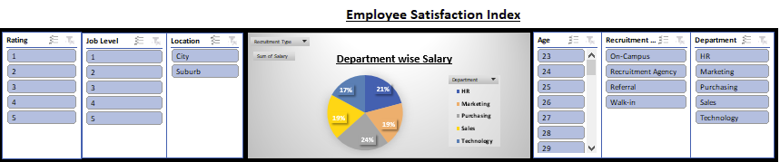
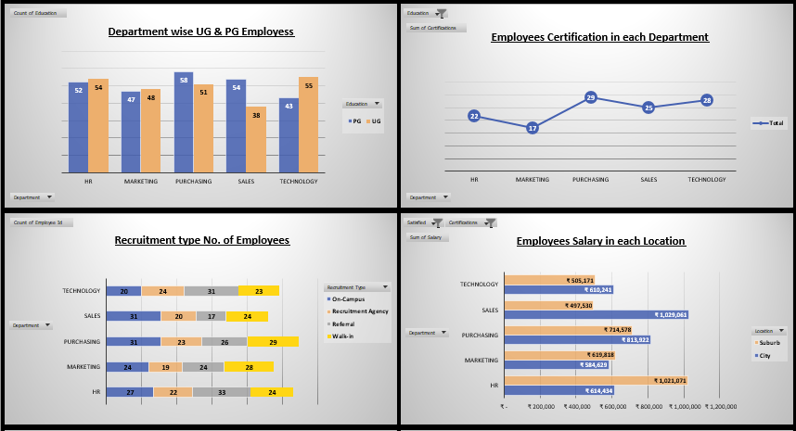
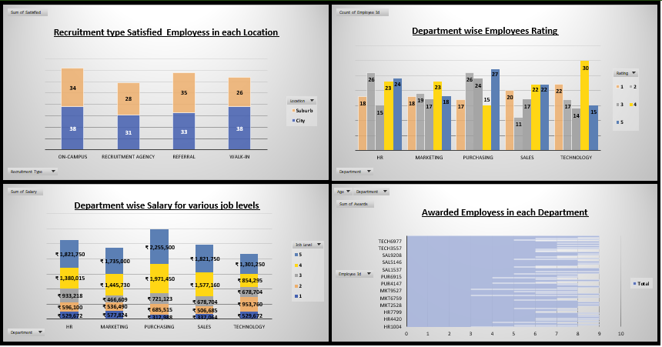
DASHBOARD

Slide 14
Conclusion :
Company needs to concentrate on factors like employees Promotion, wages, so this will result in more employees satisfaction & When employee satisfied that means, improvement in companies productivity & also increasing company Sales lead to more Profit.

Slide 15
THANK YOU !!!

